Slide 1
Introduction to DBMS

Slide 2
What Is a DBMS?
A very large, integrated collection of data.
Models real-world enterprise.
Entities (e.g., students, courses)
Relationships
A Database Management System (DBMS) is a software package designed to store and manage databases

Slide 3
Files vs. DBMS
Application must stage large datasets between main memory and secondary storage (e.g., buffering, page-oriented access, 32-bit addressing, etc.)
Special code for different queries
Must protect data from inconsistency due to multiple concurrent users
Crash recovery
Security and access control

Slide 4
Why Use a DBMS?
Data independence and efficient access.
Reduced application development time.
Data integrity and security.
Uniform data administration.
Concurrent access, recovery from crashes

Slide 5
Database Applications
Applications where we use Database Management Systems are:
Telecom: There is a database to keeps track of the information regarding calls made, network usage, customer details etc. Without the database systems it is hard to maintain that huge amount of data that keeps updating every millisecond.
Industry: Where it is a manufacturing unit, warehouse or distribution centre, each one needs a database to keep the records of ins and outs. For example distribution centre should keep a track of the product units that supplied into the centre as well as the products that got delivered out from the distribution centre on each day; this is where DBMS comes into picture.
Banking System: For storing customer info, tracking day to day credit and debit transactions, generating bank statements etc. All this work has been done with the help of Database management systems.
Education sector: Database systems are frequently used in schools and colleges to store and retrieve the data regarding student details, staff details, course details, exam details, payroll data, attendance details, fees details etc. There is a hell lot amount of inter-related data that needs to be stored and retrieved in an efficient manner.
Online shopping: You must be aware of the online shopping websites such as Amazon, Flipkart etc. These sites store the product information, your addresses and preferences, credit details and provide you the relevant list of products based on your query. All this involves a Database management system.

Slide 6
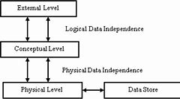
THREE TIER ARCHITECTURE OF DBMS

Slide 7
LEVEL OF ABSTRACTION
Database systems are made-up of complex data structures. To ease the user interaction with database, the developers hide internal irrelevant details from users. This process of hiding irrelevant details from user is called data abstraction.
We have three levels of abstraction:
Physical level: This is the lowest level of data abstraction. It describes how data is actually stored in database. You can get the complex data structure details at this level.
Logical level: This is the middle level of 3-level data abstraction architecture. It describes what data is stored in database.
View level: Highest level of data abstraction. This level describes the user interaction with database system.

Slide 8
DATA INDEPENDENCE
Defines as the capacity to change the schema at one level of a database system without having to change the schema at the next higher level.
Types of Data Independence
Logical Data Independence
Physical Data Independence

Slide 9
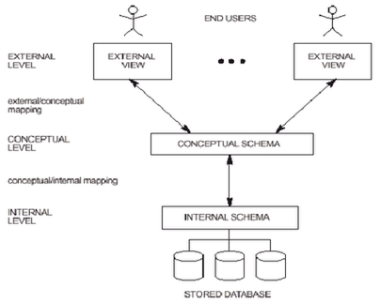

Slide 10
Data Models
A data model is a collection of concepts for describing data.
A schema is a description of a particular collection of data, using the a given data model.
The relational model of data is the most widely used model today.
Main concept: relation, basically a table with rows and columns.
Every relation has a schema, which describes the columns, or fields.

